Slide 1

Department of Computer Science and Engineering
BRAIN TUMOR DETECTION USING DEEP LEARNING WITH
EFFICIENT NET –B0
PRESENTED BY
Bollisetty Triveni
Devarasetty Rama Durga Bhavani Pondugula Hemantha Lakshmi
(21471A05M0) (21471A05M3) (21471A05O4)
Under the Guidance of,
Y.Chandana MTech
Designation,
Department of Computer Science and Engineering, Narasaraopeta Engineering College (Autonomous),
Narasaraopet- 522 601.
Review No.
Department of CSE
2

Slide 2
OUTLINE
Abstract
Introduction
Literature Survey
Research Gaps
Problem Statement
Objectives
Block Diagram / Flow Diagram
Methodology
Implementation
Results and Analysis
Conclusion & Future Scope
References
Question and Answers
Acknowledgements
Review No.
Department of CSE
2

Slide 3
ABSTRACT
Brain tumors, though rare, are life-threatening conditions requiring timely and accurate diagnosis. Manual analysis of MRI images by radiologists is time- consuming, prone to errors, and relies heavily on expertise. This research presents a robust deep learning-based approach for brain tumor detection and classification, leveraging a fine-tuned EfficientNet-B0 model.
The EfficientNet-B0 model, optimized through transfer learning and additional layers, demonstrated superior accuracy of 98.87%, outperforming other deep learning models like VGG16, ResNet50, and InceptionV3. Regularization techniques such as dropout and L2 regularization were applied to prevent overfitting, while performance metrics including precision, recall, and F1-score ensured comprehensive evaluation
Review No.
Department of CSE
3

Slide 4
INTRODUCTION
Overview: Brain tumor detection is a critical task in the healthcare domain, where early and accurate diagnosis significantly impacts patient outcomes.
Problem: Traditional machine learning models face challenges in achieving high accuracy due to the complexity of tumor morphology and high-dimensional medical imaging datasets.
Objective: Introduced EfficientNetB0-TumorNet, a novel deep learning model leveraging the EfficientNetB0 architecture for feature extraction and classification, optimized for accurate brain tumor detection.
Significance: EfficientNetB0-TumorNet enhances diagnostic capabilities through improved prediction accuracy, outperforming existing models by better capturing feature importance and addressing the challenges of imbalanced datasets.
2•7-1.2-2024
Review No.
Batch No.
Department of CSE
4

Slide 5
LITERATURE SURVEY
No | Title | Author | Journal Name & Year | Methodology Adapted | Key Findings | Gaps
1 | On the Performance of Deep Transfer Learning Networks for Brain Tumor Detection Using MR Images | Chetana Srinivas, N. K. Srinath, and M. A. Bhagyaveni. | https://www.ncbi.nl m.nih.gov/pmc/articl es/PMC8923754/ | The study conducts a comparative performance analysis of transfer learning-based Convolutional Neural Network (CNN) models. | The research highlights the potential of deep transfer learning. | Needs lightweight models for low- resource environments.
2 | VGG- SCNet_A_VGG_Net- Based_Deep_Learning_ Framework_for_Brain_T umor_Detection_on_M RI_Images | Md. Majib Rahman and Md. Kamrul Hasan. | https://ieeexplore.ie ee.org/document/95 15947 | Transforms non-image data into image-like structures for CNN | Outperforme d traditional machine learning methods in classifying brain tumor images. | Framework is not optimized for energy efficiency or real-time clinical use.
3 | Optimized_Brain_Tumo r_Detection_A_Dual- Module_Approach_for_ MRI_Image_Enhanceme nt_and_Tumor_Classific at | Saha, S., et al. | https://ieeexplore.ie ee.org/document/10 535472/ | The fine-tuned ResNet50 model demonstrated high accuracy in classifying brain tumors from MRI images | The study employs the ResNet50 architecture, a deep convolutional. | Requires simpler models that work well in real-time with less computational power.

Slide 6
4 | Automated_Brain_Tum or_Segmentation_and_ Classification_in_MRI_U sing_YOLO- Based_Deep_Learning | Krishna, E. R., & Devarakonda, N | https://ieeexplore.ie ee.org/document/10 415378/ | The study compares two popular object detection models, YOLOv5 and YOLOv7, using advanced deep learning techniques to identify and classify brain tumors in MRI images. | YOLOv5 achieved good accuracy for segmentation and classification of brain tumors. | Does not explore advanced techniques like hybrid or transformer-based models for better performance.
5 | Developments_in_Brain_ Tumor_Segmentation_Us ng_MRI_Deep_Learning _Insights_and_Future_Pe rspectives. | Eluri, R. K., & Devarakonda, N. | https://ieeexplore.ie ee.org/document/10 431786/ | The study looks into the latest deep learning methods used for brain tumor segmentation in MRI scans. | Improved accuracy and efficiency in brain tumor segmentation using deep learning. | Lacks comparison with EfficientNet-B0 or similar efficient models to reduce computational needs.

Slide 7
RESEARCH GAPS
Lack of Effective Attention Mechanisms
Previous deep learning models struggled to prioritize critical features in MRI images, reducing interpretability and detection accuracy.
Traditional machine learning methods relied on manual feature selection, which introduced human bias and limited the discovery ofof intricate patterns in medical imaging data.
Challenges with Imbalanced Datasets
Many models failed to adequately address class imbalance, leading to biased predictions favouring non-tumor classes over tumor classes.
Limited Scalability for Real-World Applications
Existing models lacked scalability and optimization for large-scale, real-time healthcare environments, restricting their utility in clinical practice.
Review No.
Department of CSE

Slide 8
PROBLEM STATEMENT
Brain tumors are abnormal growths of cells in the brain that can be life-threatening if not detected early.
Early and accurate detection is crucial for timely treatment and improved patient outcomes.
Traditional diagnostic methods, such as MRI scans, require expert radiologists for interpretation.
Manual diagnosis is time-consuming, subjective, and prone to human error.
Automated brain tumor detection using machine learning and deep learning can enhance accuracy and efficiency.
The system should classify MRI scans into tumor and non-tumor categories.
Further classification into tumor types (e.g., glioma, meningioma, pituitary) can aid in personalized treatment.
The model should be trained on a large dataset of labeled MRI images for better generalization.
Review No.
Department of CSE

Slide 9
OBJECTIVES
Developing an Efficient Detection Model: The primary goal of this research is to create a robust deep learning model for accurate detection and classification of brain tumors using MRI images.
Enhancing Image Quality and Dataset Variability: To improve model performance, the study focuses on enhancing the quality of MRI images through preprocessing techniques like Gaussian blurring, erosion, dilation, and noise injection.
Comparative Analysis of Deep Learning Models: The research conducts a thorough comparative analysis of several deep learning models, including VGG16, ResNet50, InceptionV3, Xception, and InceptionResNetV2, against the proposed EfficientNet-B0 model.
Review No.
Department of CSE

Slide 10
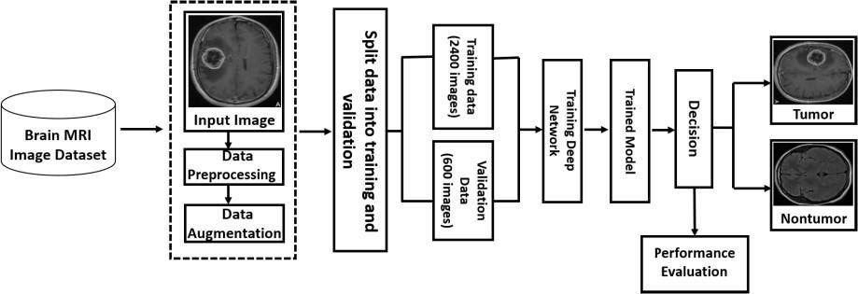
BLOCK DIAGRAM OR FLOW DIAGRAM
Review No.
Department of CSE

Slide 11

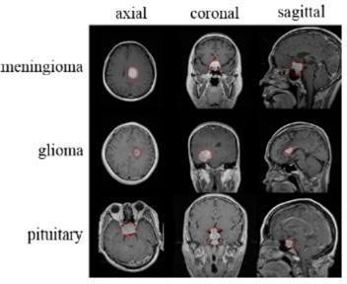
METHODOLOGY
The methods used are:
Image Conversion and Resizing: All images were converted to grayscale to simplify computations while retaining important features.
Noise Reduction and Enhancement: Applied to reduce noise and enhance the image quality
Morphological Transformations: Shrinks white regions (e.g., tumor areas) by erasing pixels at the object boundaries, reducing noise.
Equations and Tools used are:
1.Binary Cross-Entropy (BCE) Loss Function:
Review No.
Department of CSE

Slide 12
Formula:
BCE=−[y⋅log(p)+(1−y)⋅log(1−p)]
2. L2 Regularization (Weight Decay):
Used to prevent overfitting by penalizing large weights. Formula:
J(W)=J0(W)+λ∑i=1nWi2J(W)
Tools:
1. Deep Learning Framework:
TensorFlow/Keras: Likely used for implementing EfficientNet-B0 and other models for fine-tuning and training.
Review No.
Department of CSE

Slide 13
2. Data Augmentation Library:
Albumentations: A Python library used for image transformations like flipping, rotation, cropping, and adding noise while preserving crucial medical image details.
Preprocessing Tools:
NumPy and OpenCV:
For grayscale conversion, resizing, and noise reduction.
Application of filters like Gaussian blur and high-pass filtering.
Visualization:
. Tools like Matplotlib or Seaborn (not explicitly mentioned but commonly used) for visualizing performance metrics, loss, and accuracy curves.
Review No.
Department of CSE

Slide 14
IMPLEMENTATION
Specifications:
Software Specifications
Programming Language:
Python (most likely, given the mention of TensorFlow and Albumentations).
Deep Learning Frameworks:
TensorFlow or PyTorch for model implementation and training.
Libraries for Preprocessing and Data Augmentation:
Albumentations: For data augmentation (flipping, cropping, noise injection, etc.).
OpenCV: For image processing tasks like resizing, grayscale conversion, and filtering.
NumPy: For numerical operations.
Other Libraries:
Matplotlib/Seaborn: For plotting training/validation metrics.
Pandas: For handling any metadata or dataset information.
Review No.
Department of CSE

Slide 15
Hardware Specifications
GPU:
A high-performance GPU is essential for training deep learning models. Likely options:
NVIDIA GPUs like RTX 2080 Ti, RTX 3090, or A100.
CUDA compatibility for TensorFlow or PyTorch acceleration.
CPU:
Multi-core processors like Intel Core i7/i9 or AMD Ryzen 7/9 for general computations.
RAM:
At least 16 GB, though 32 GB or more is preferred for handling large datasets.
Storage:
SSD with at least 500 GB capacity for faster data access and storage of models, datasets, and checkpoints.
Operating System:
Linux-based systems (e.g., Ubuntu) are typically preferred for deep learning tasks, though Windows with WSL (Windows Subsystem for Linux) is also a viable option.
Challenges Faced:
Limited Annotated Datasets:
Medical imaging datasets are often small and lack sufficient annotated examples, making it difficult to train deep learning models effectively.
Noise and Artifacts in MRI Images:
MRI scans may contain noise and artifacts due to variations in scanning equipment or patient movement, which can reduce model accuracy.
Overfitting:
Deep learning models, especially with limited data, may overfit, leading to poor generalization on unseen data.
Review No.
Department of CSE

Slide 16
How These Challenges Were Overcome
Data Augmentation:
Techniques like flipping, rotation, cropping, and adding noise were applied to create diverse images, effectively increasing the dataset size and improving generalization.
Preprocessing Techniques:
Steps like Gaussian blur for noise reduction and high-pass filters for sharpening ensured that the quality of MRI images was enhanced, reducing the impact of noise and artifacts.
Transfer Learning:
Pre-trained EfficientNet-B0 and other models were fine-tuned on the dataset, leveraging knowledge from large-scale datasets to improve performance with limited data.
Regularization Techniques:
Dropout and L2 regularization were employed to mitigate overfitting by preventing the model from relying too heavily on specific features.
Normalization:
Pixel values were normalized to a range of 0 to 1, ensuring consistent input for the models and faster convergence during training.
Balanced Dataset Handling:
Data augmentation was applied equally to all classes, ensuring balanced representation and reducing bias in the model predictions.
Robust Model Architecture:
EfficientNet-B0 was chosen for its efficiency and ability to scale depth, width, and resolution, allowing it to adapt well to the complexity of the task.
Review No.
Department of CSE

Slide 17
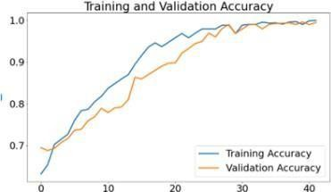
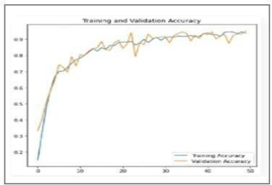
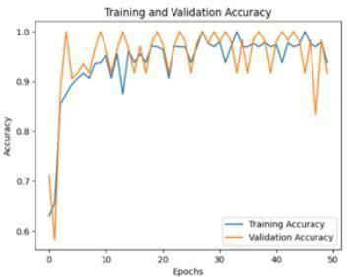
RESULTS & ANALYSIS
Datasets and Performance: Datasets Used: EfficientNet-B0, ResNet50, Xception.
Results Summary:
EfficientNet-B0: Accuracy improved from 97.8% (without balancing) to 98.87% with SMOTEEN. ResNet50: Accuracy increased from 90.52% to 95.8%.
Xception: Accuracy rose from 92.86% to 97.08%.
Review No.
Department of CSE

Slide 18
CONCLUSION AND FUTURE SCOPE
Conclusion:
By leveraging the EfficientNet-B0 model, enhanced with fine-tuning and optimized layers, the proposed approach achieved remarkable accuracy (98.87%) and outperformed traditional convolutional neural networks such as VGG16, ResNet50, and InceptionV3.
Key preprocessing steps like noise reduction, data augmentation, and normalization further improved model performance and generalizability..
Future Scope :
Integrate ensemble learning techniques for better feature extraction and classification..
Combine MRIdata with other diagnosticmodalities like CT scans or histopathological data for a comprehensive diagnostic tool.
Develop user-friendly software for radiologists and medical practitioners..
Review No.
Department of CSE

Slide 19
REFERENCES
H. A. Shah, F. Saeed, S. Yun, J.-H. Park, A. Paul, and J.-M. Kang, “A Robust Approach for Brain Tumor Detection in Magnetic Resonance Images Using Finetuned
EfficientNet,” IEEE Access, vol. 10, pp. 65426– 65438, 2022, doi: 10.1109/ACCESS.2022.3184113.
A. Younis et al., “Abnormal Brain Tumors Classification Using ResNet50 and Its Comprehensive Evaluation,” IEEE Access, vol. 12, pp. 78843–78853, 2024, doi: 10.1109/ACCESS.2024.3403902.
M. Li, L. Kuang, S. Xu, and Z. Sha, “Brain Tumor Detection Based on Multimodal Information Fusion and Convolutional Neural Network,” IEEE Access, vol. 7, pp. 180134–180146, 2019, doi: 10.1109/ACCESS.2019.2958370.
T. Vaiyapuri, J. Mahalingam, S. Ahmad, H. A. M. Abdeljaber, E. Yang, and S.-Y. Jeong, “Ensemble Learning Driven Computer-Aided Diagnosis Model for Brain Tumor Classification on Magnetic Resonance Imaging,” IEEE Access, vol. 11, pp. 91398–91406, 2023, doi: 10.1109/ACCESS.2023.3306961.
S. Karim et al., “Developments in Brain Tumor Segmentation Using MRI: Deep Learning Insights and Future Perspectives,” IEEE Access, vol. 12, pp. 26875–26896, 2024, doi: 10.1109/ACCESS.2024.3365048.
N. Noreen, S. Palaniappan, A. Qayyum, I. Ahmad, M. Imran, and M. Shoaib, “A Deep Learning Model Based on Concatenation Approach for the Diagnosis of Brain
Tumor,” IEEE Access, vol. 8, pp. 55135–55144, 2020, doi: 10.1109/ACCESS.2020.2978629.
M. F. Almufareh, M. Imran, A. Khan, M. Humayun, and M. Asim, “Automated Brain Tumor Segmentation and Classification in MRI Using YOLO-Based Deep
Learning,” IEEE Access, vol. 12, pp. 16189–16207, 2024, doi: 10.1109/ACCESS.2024.3359418.
S. Ahmad and P. K. Choudhury, “On the Performance of Deep Transfer Learning Networks for Brain Tumor Detection Using MR Images,” IEEE Access, vol. 10, pp. 59099–59114, 2022, doi: 10.1109/ACCESS.2022.3179376.
M. S. Majib, M. M. Rahman, T. M. S. Sazzad, N. I. Khan, and S. K. Dey, “VGG-SCNet: A VGG Net-Based Deep Learning Framework for Brain Tumor Detection on MRI Images,” IEEE Access, vol. 9, pp. 116942–116952, 2021, doi: 10.1109/ACCESS.2021.3105874.
A. A. Asiri, T. A. Soomro, A. A. Shah, G. Pogrebna, M. Irfan, and S. Alqahtani, “Optimized Brain Tumor Detection: A Dual-Module Approach for MRI Image Enhancement and Tumor Classification,” IEEE Access, vol. 12, pp. 42868–42887, 2024, doi: 10.1109/ACCESS.2024.3379136
Review No.
Department of CSE

Slide 20
QUESTIONS and ANSWERS
Please ask Questions if there are any doubts
Review No.
Department of CSE

Slide 21
ACKNOWLEGEMENTS
I would like to express my heartfelt gratitude for the opportunity to present this work and share insights on the project.
A special thanks to my mentors, team members, and all those who supported this journey.
For Further Inquiries
Email Phone No
: trivenibollisetty123@gmail.com
: 8247213104
Review No.
Department of CSE

